Slide 1
IT305 Computer Networks
Packet Scheduling

Slide 2
Packet Scheduling: FCFS
packet scheduling: deciding which packet to send next on link
first come, first served
priority
round robin
weighted fair queueing
FCFS: packets transmitted in order of arrival to output port
also known as: First-in-first-out (FIFO)
real world examples?
Abstraction: queue
R
packet
departures
packet
arrivals
queue
(waiting area)
link
(server)

Slide 3
Scheduling policies: priority
Priority scheduling:
arriving traffic classified, queued by class
any header fields can be used for classification
high priority queue
arrivals
classify
link
departures
low priority queue
2
send packet from highest priority queue that has buffered packets
FCFS within priority class
1
3
4
5
arrivals
packet in service
1
3
2
4
5
departures
1
3
2
4
5

Slide 4
Scheduling policies: round robin
Round Robin (RR) scheduling:
arriving traffic classified, queued by class
any header fields can be used for classification
server cyclically, repeatedly scans class queues, sending one complete packet from each class (if available) in turn
R
classify
arrivals
link
departures

Slide 5
Scheduling policies: weighted fair queueing
Weighted Fair Queuing (WFQ):
generalized Round Robin
each class, i, has weight, w_{i}, and gets weighted amount of service in each cycle:
w₁
w₂
R
w_{i}
Σ_{j}w_{j}
classify
arrivals
link
departures
w₃
minimum bandwidth guarantee (per-traffic-class)

Slide 6
Policing packet flow
Max number packets entering a network = rt+ b
r is token generation rate
b num tokens

Slide 7
Network-layer functions
forwarding: move packets from router’s input to appropriate router output
data plane
routing: determine route taken by packets from source to destination
control plane
Two approaches to structuring network control plane:
per-router control (traditional)
logically centralized control (software defined networking)

Slide 8
Software defined networking (SDN)
Internet network layer: historically implemented via distributed, per-router control approach:
monolithic router contains switching hardware, runs proprietary implementation of Internet standard protocols (IP, RIP, IS-IS, OSPF, BGP) in proprietary router OS (e.g., Cisco IOS)
different “middleboxes” for different network layer functions: firewalls, load balancers, NAT boxes, ..
~2005: renewed interest in rethinking network control plane

Slide 9

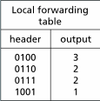
Per-router control plane
Individual routing algorithm components in each and every router interact in the control plane
Routing
Algorithm
control
plane
data
plane
values in arriving
packet header
0111
1
3
2

Slide 10
Software defined networking (SDN)
Why a logically centralized control plane?
easier network management: avoid router misconfigurations, greater flexibility of traffic flows
table-based forwarding (recall OpenFlow API) allows “programming” routers
centralized “programming” easier: compute tables centrally and distribute
distributed “programming” more difficult: compute tables as result of distributed algorithm (protocol) implemented in each-and-every router
open (non-proprietary) implementation of control plane
foster innovation: let 1000 flowers bloom

Slide 11
Software-Defined Networking (SDN) control plane
Remote controller computes, installs forwarding tables in routers
Remote Controller
control
plane
data
plane
CA
CA
CA
CA
CA
values in arriving
packet header
0111
1
3
2

Slide 12
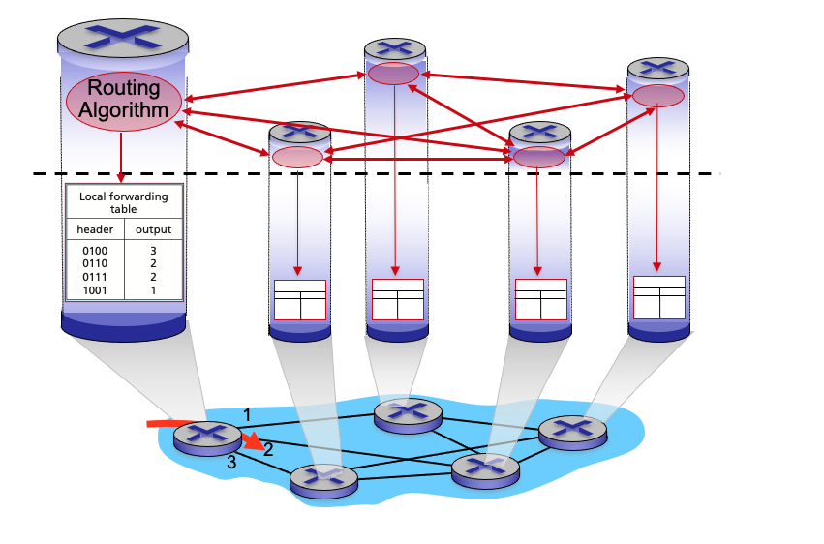
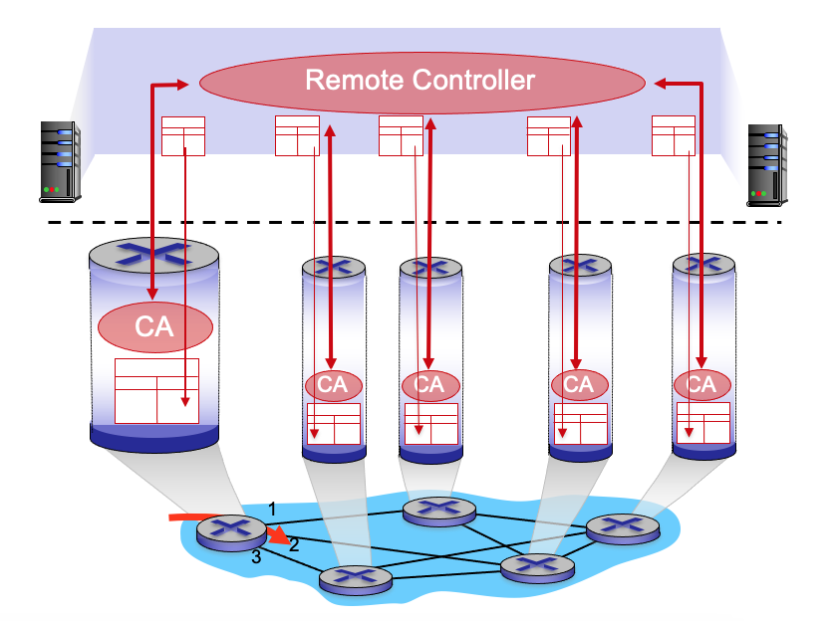
Per-router control plane
SDN control plane

Slide 13
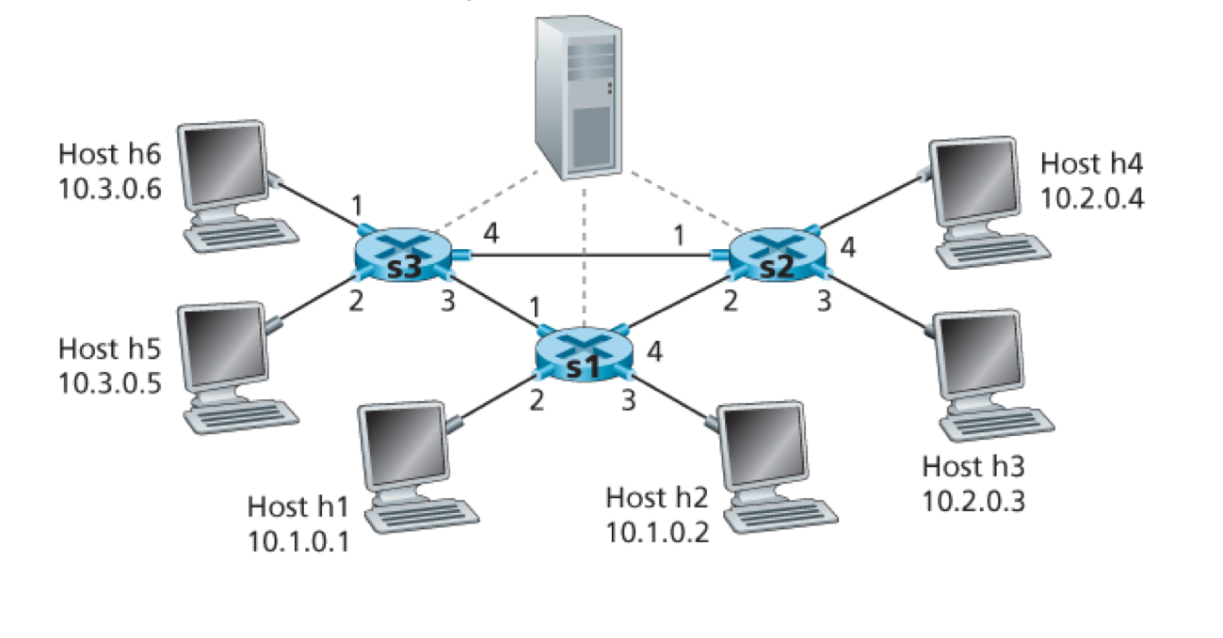

Slide 14
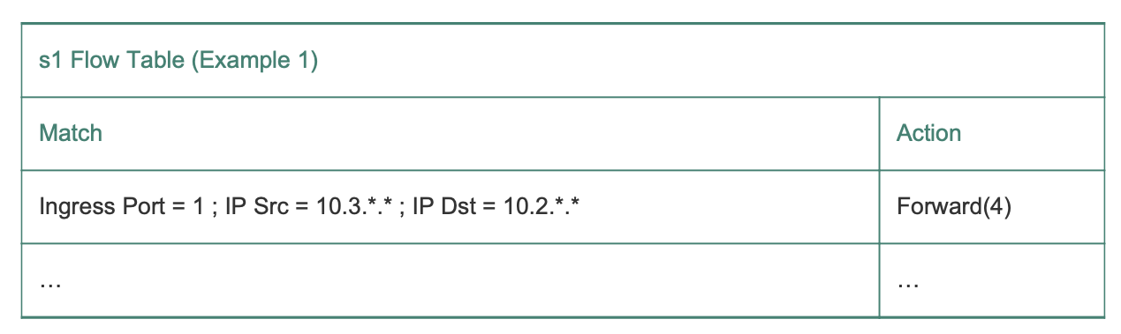
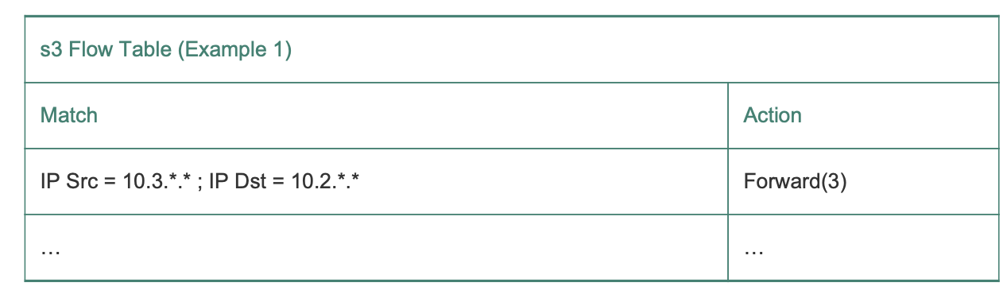

Slide 15
